Slide 1
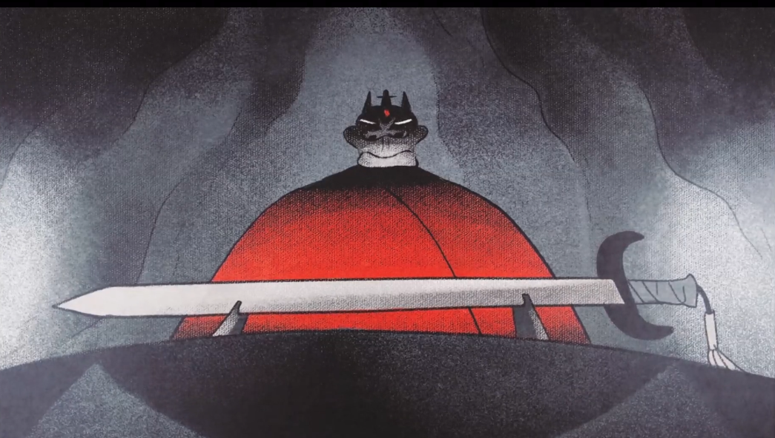
👒
👁️
👁️
👄
🥇
💐

Slide 2
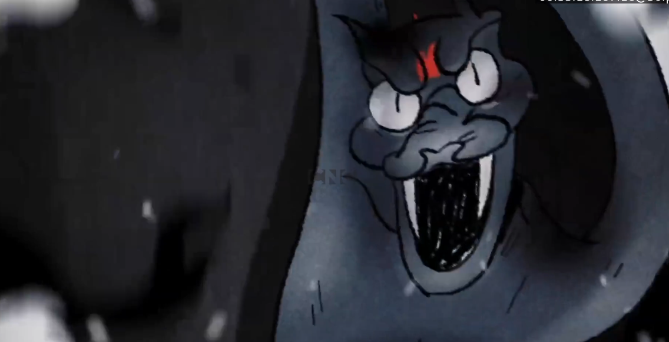
🎊
🦠
🦠
🎀

Slide 3






